Slide 1
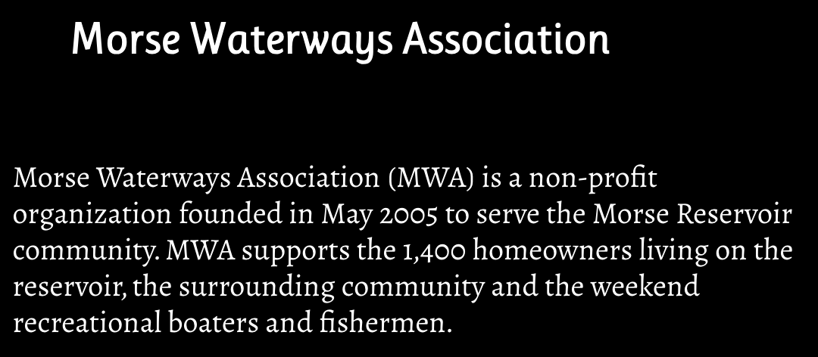
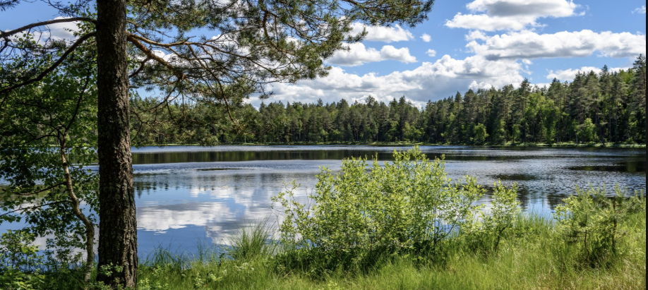
Coast Guard Auxiliary Presentation
Presentation May 13th 2026

Slide 2

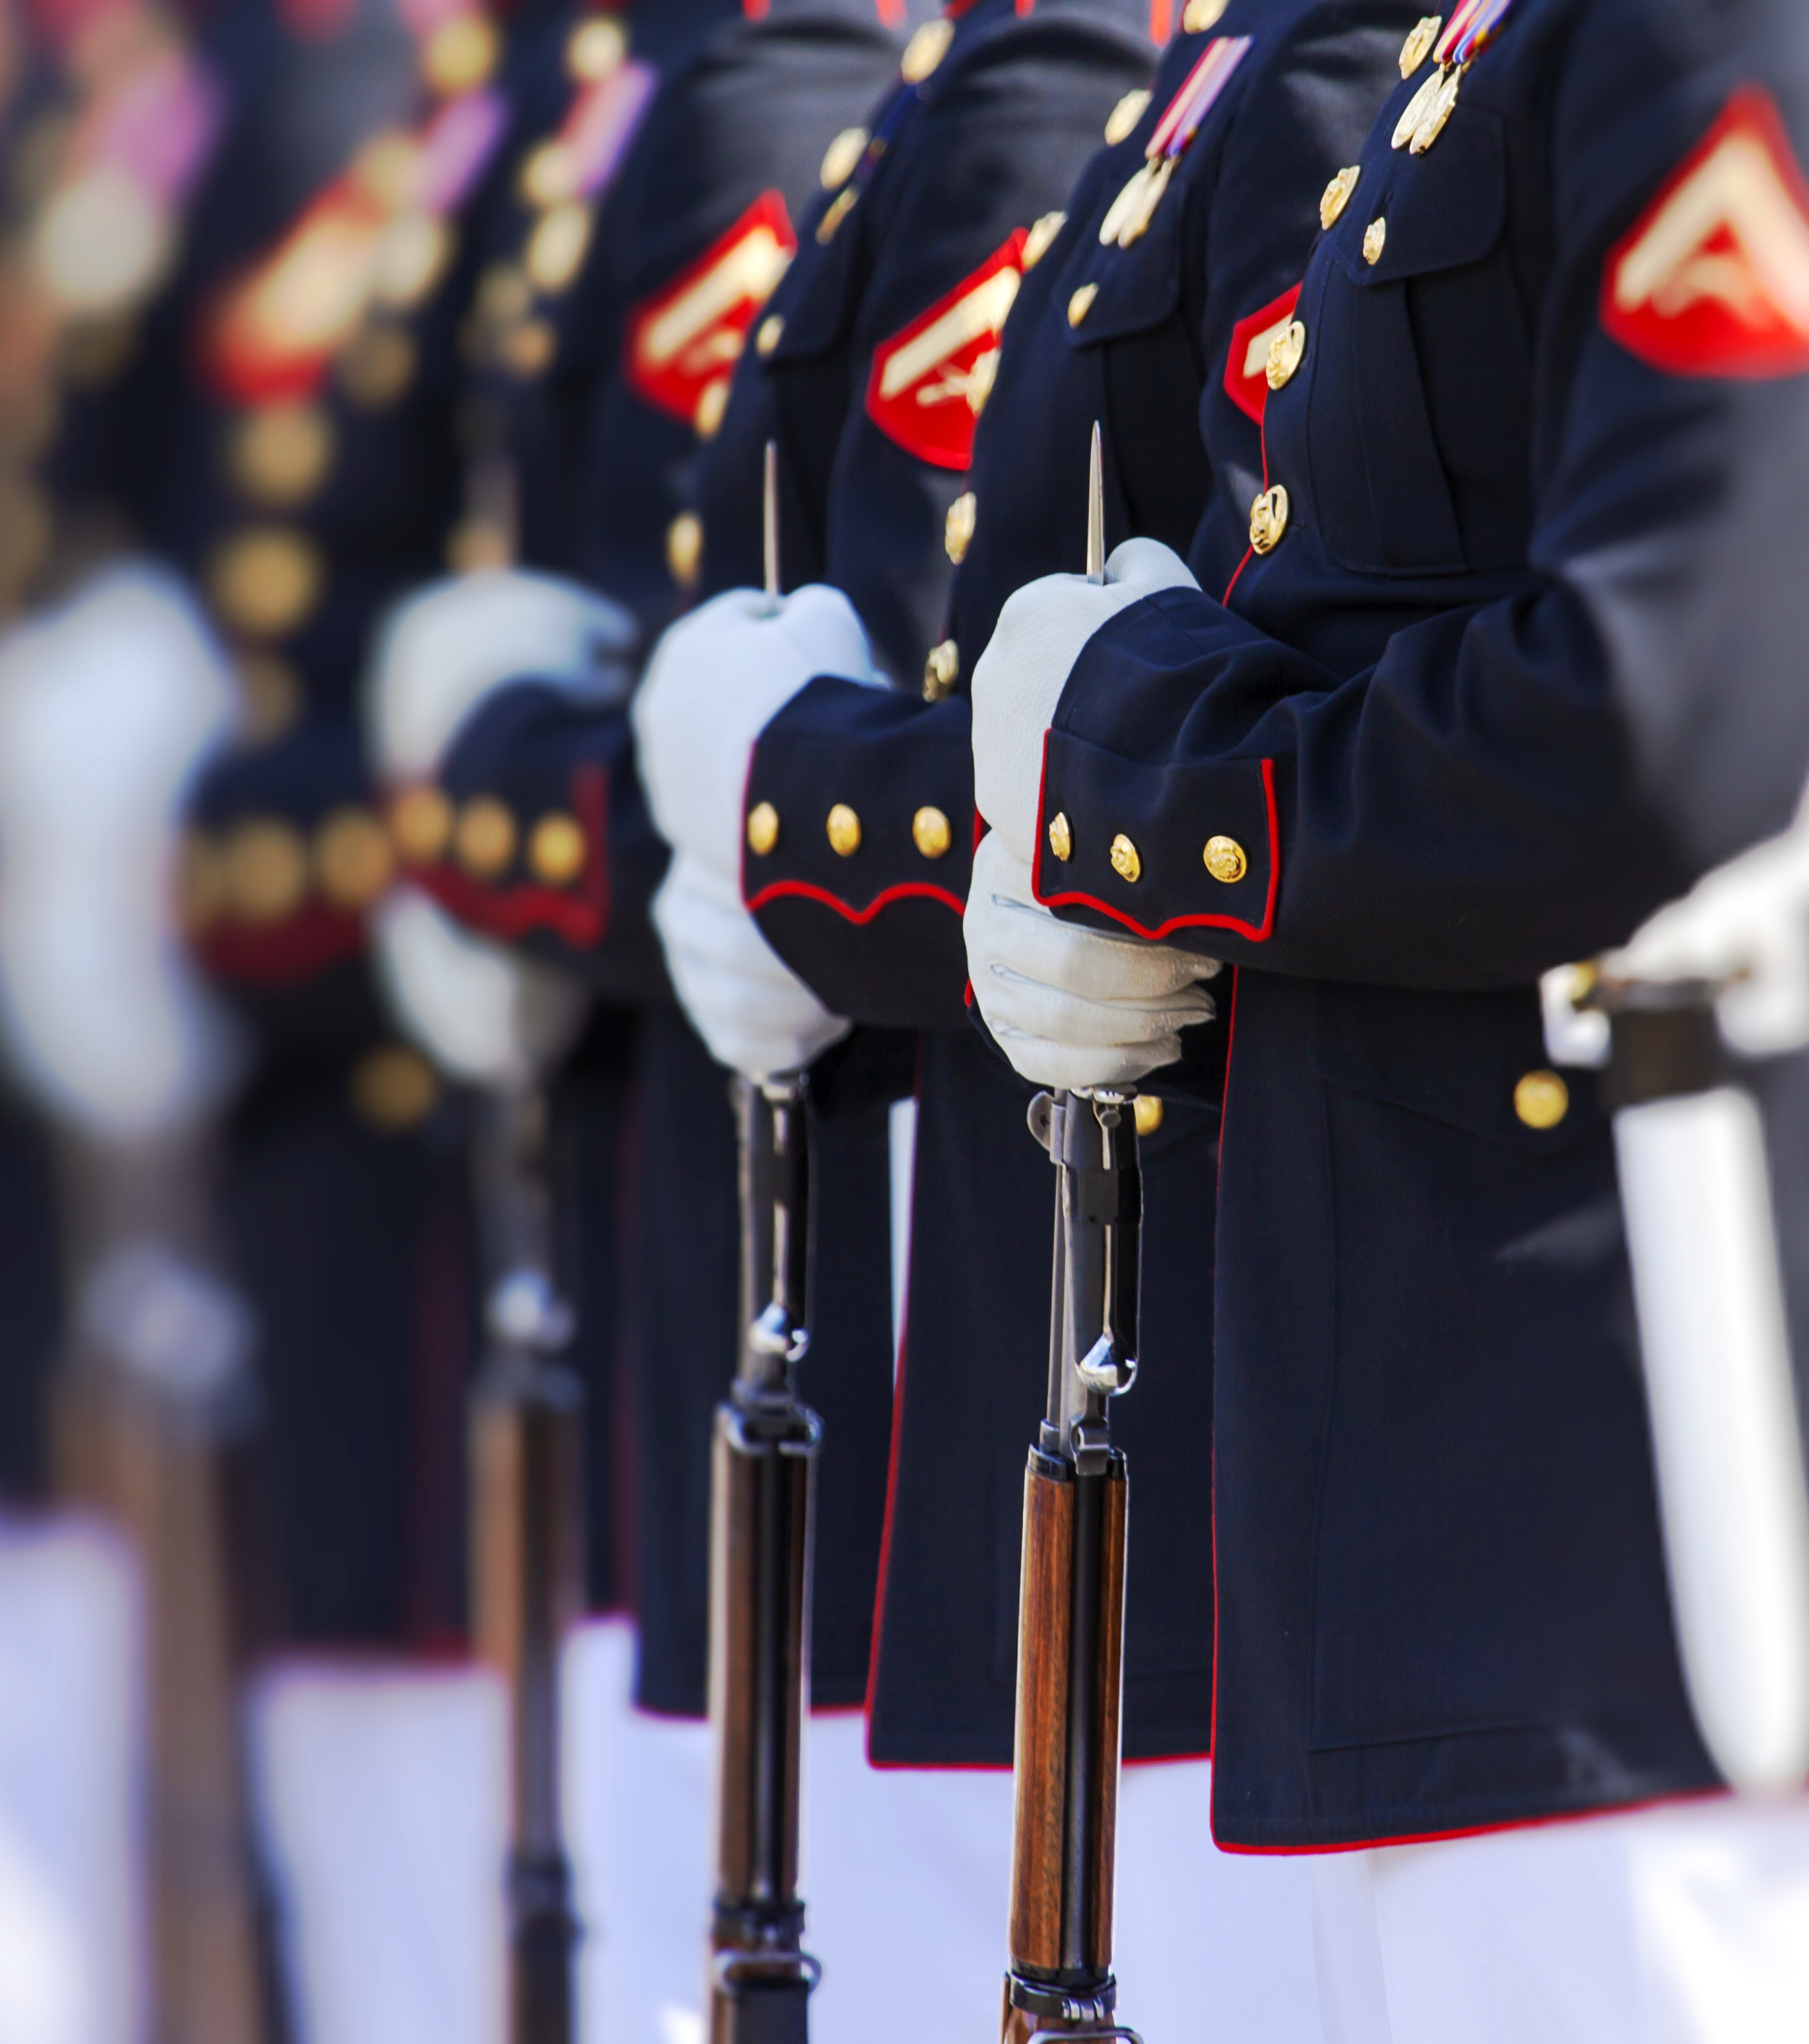
Coast Guard Marine Safety: Balancing Prevention and Response
Julian Ungar-Sargon
Marine Safety Officer, Division 1 District 8-ER

Slide 3
Our Mission – The Heart of Marine Safety
1. To promote and improve Recreational Boating Safety.
2. To support the Coast Guard in all its missions except direct law enforcement and military engagement.
Marine Safety fulfills these through Prevention, Response, and Community Engagement.

Slide 4


Sea partners Program 2026
Julian Ungar-Sargon ADSO-MS D8ER

Slide 5
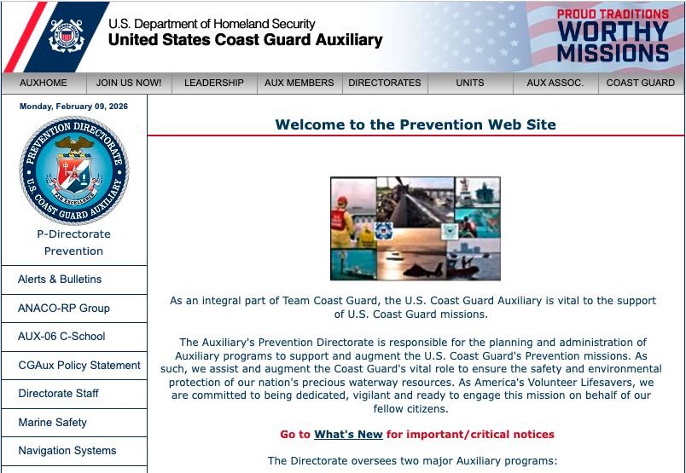

Slide 6


Slide 7
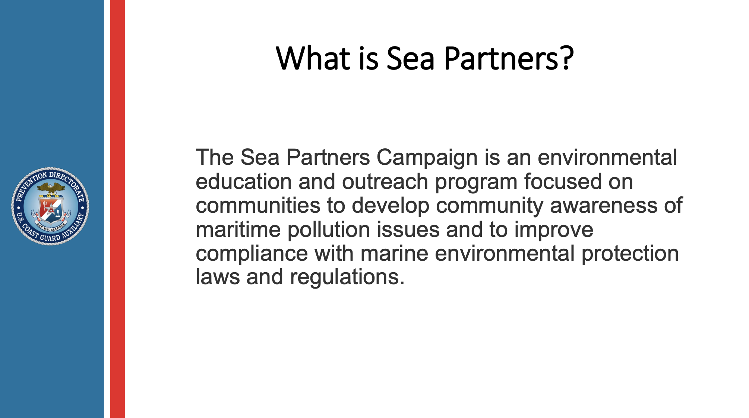

Slide 8
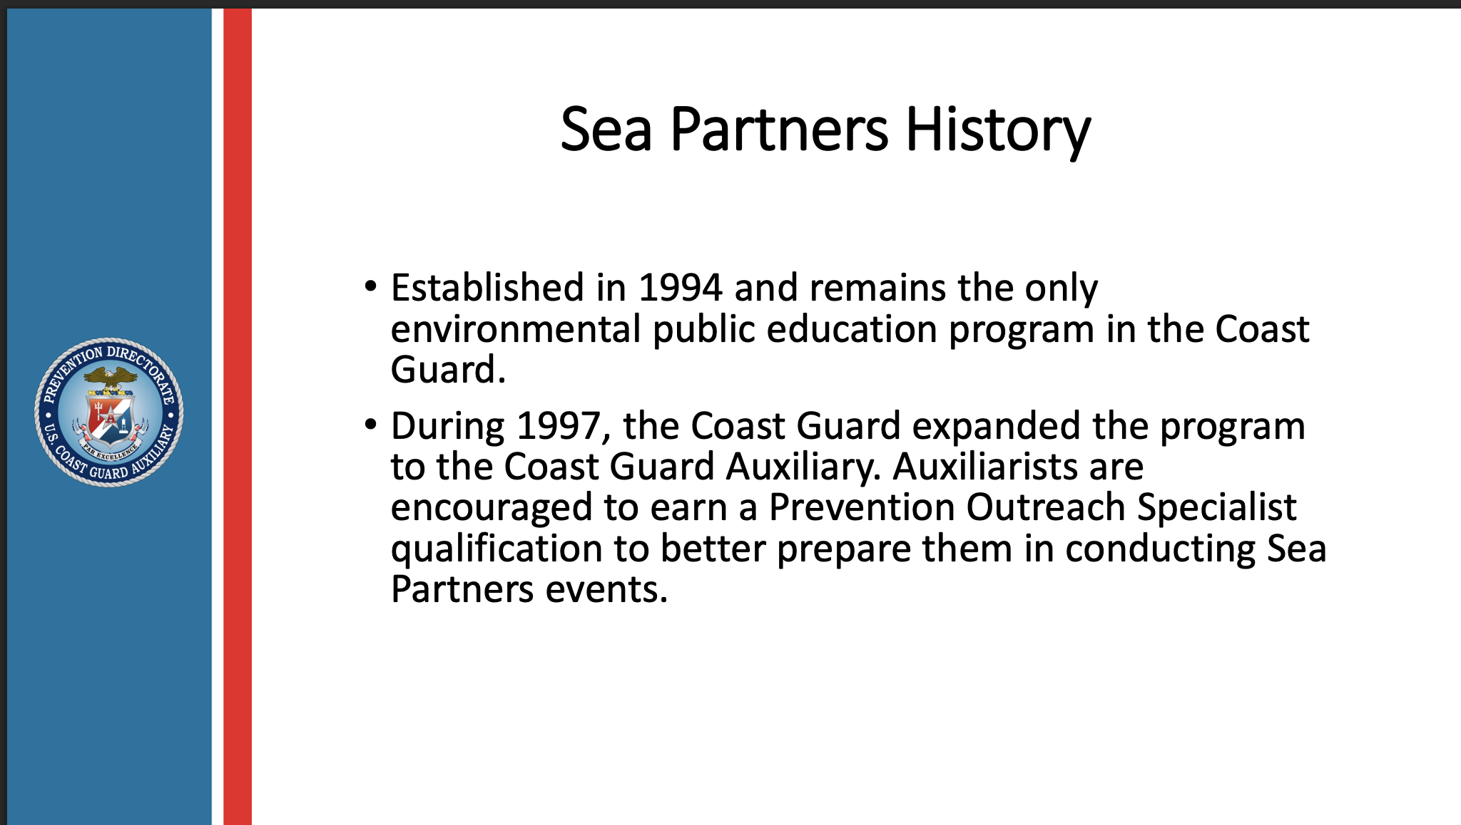

Slide 9
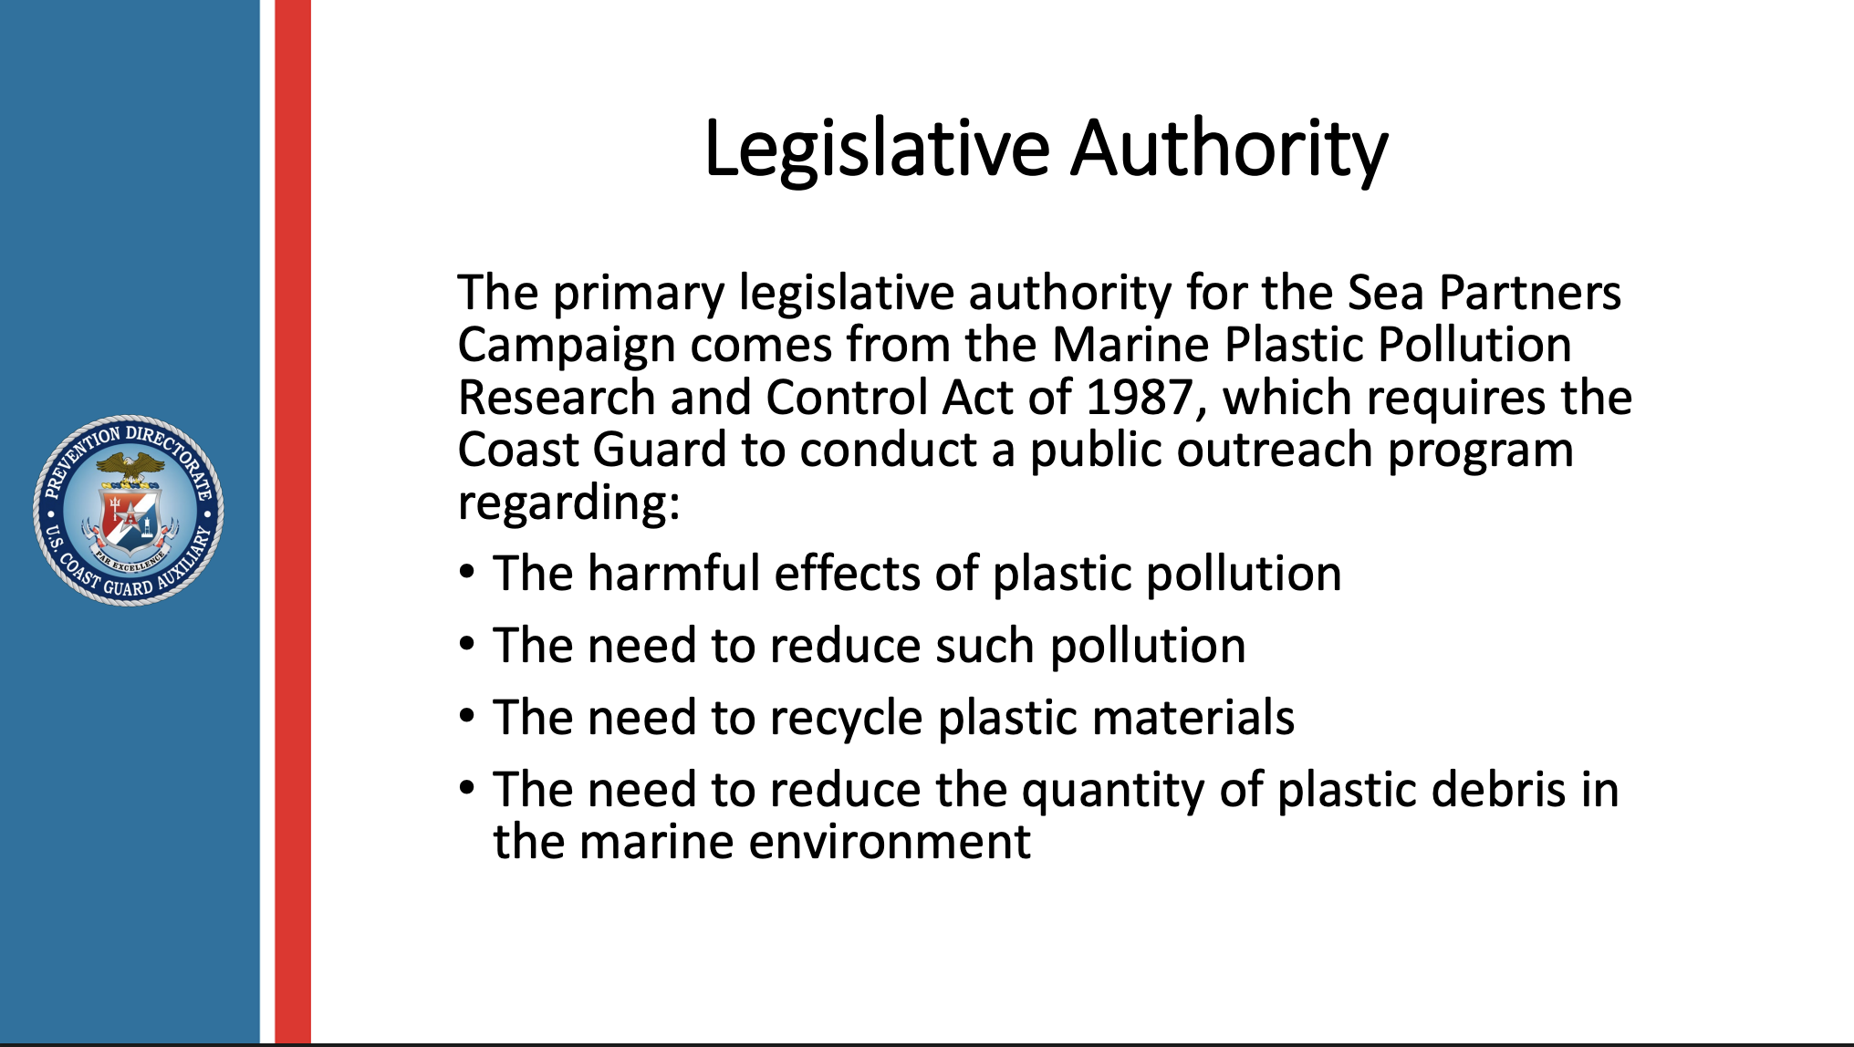

Slide 10
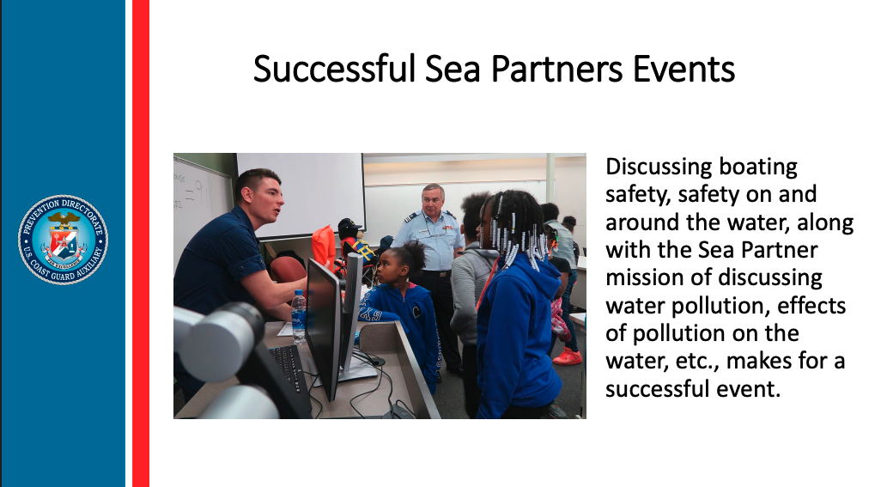

Slide 11


Slide 12
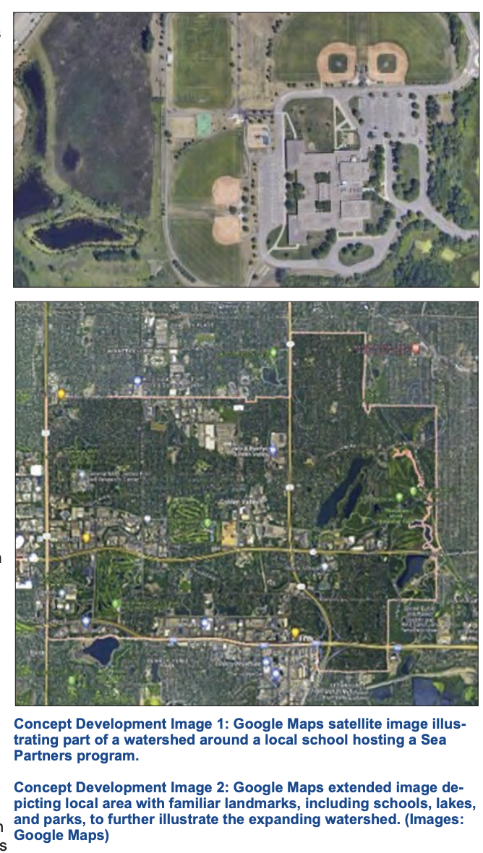
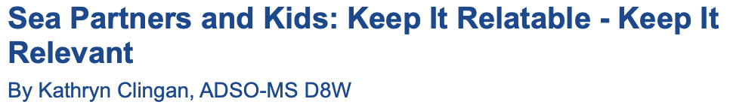

Slide 13
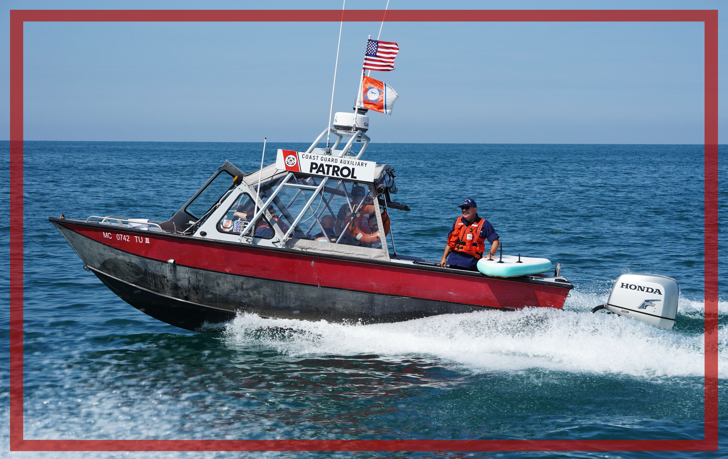
Why Marine Safety? Why Now?
• Over 75,000 lives saved since 1971
• 50% decrease in recreational boating fatalities despite traffic doubling
• 'Semper Paratus' means readiness that protects

Slide 14
